Slide 1


Presentation
NEXT.Js
The React Framework for the Web
Used by some of the world's largest companies,
Next.js enables you to create high-quality web applications with the power of React components.
.
Made By:
SAMREEN

Slide 2
.
Table of content
01- What is the page.tsx file.?
02- What is the layout.tsx file?
03- What is the Link tag, why do we use this tag, and what is its purpose?
04- How can we create nested pages in Next.js?
05- What are components, and why do we use them?
06- How can we apply CSS in Next.js?
07- What is Tailwind CSS, and what are the differences between Tailwind
CSS and standard CSS?
Notes:
All slides are completed

Slide 3
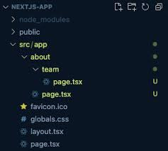
1. What is page.tsx file?
Definition:
The page.tsx file is a special file in Next.js that defines a route. Each file in the app directory corresponds to a route in the application.
Purpose:
It contains the React component that renders the content for that specific route.

Slide 4
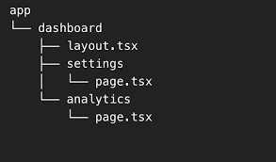
2. What is layout.tsx file?
Definition:
The layout.tsx file is used to define the layout structure for your pages.
Purpose:
It allows you to apply consistent UI elements (like headers, footers, sidebars) across multiple pages without duplicating code.

Slide 5
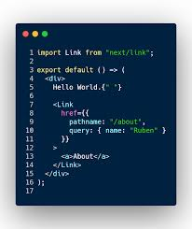
3- What is the Link tag?
Definition:
The <link> tag defines the relationship between the current document and an external resource.
The <link> tag is most often used to link to external style sheets or to add a favicon to your website. The <link> element is an empty element, it contains attributes only.
Example:
import Link from 'next/link';
<Link href="/about">About Us</Link>

Slide 6
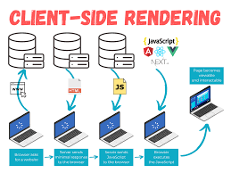
What are the Purpose of the Link tag?
Client-Side Navigation:
The <Link> component allows for seamless navigation without a full page reload. This enhances user experience by making transitions faster.
Prefetching:
Next.js automatically prefetches linked pages when they come into view (if the user is on a page long enough). This means that the linked page is already loaded in the background, making navigation instantaneous.
Accessibility: The <Link> component handles accessibility concerns, such as ensuring that the linked elements are keyboard navigable.

Slide 7
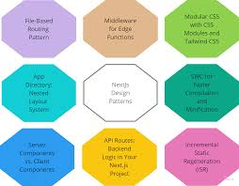
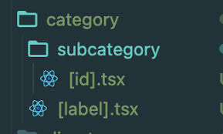
4- How to Create Nested Pages in Next.js?
Next.js uses file-system routing where folders are used to create nested routes. Each folder represents a route segment that maps to a URL segment.
page.tsx is a special Next.js file that exports a React component, and it's required for the route to be accessible. In your application, you already have a page file: /app/page.tsx - this is the home page associated with the route / . /app/dashboard/page.tsx is associated with the /dashboard path.

Slide 8
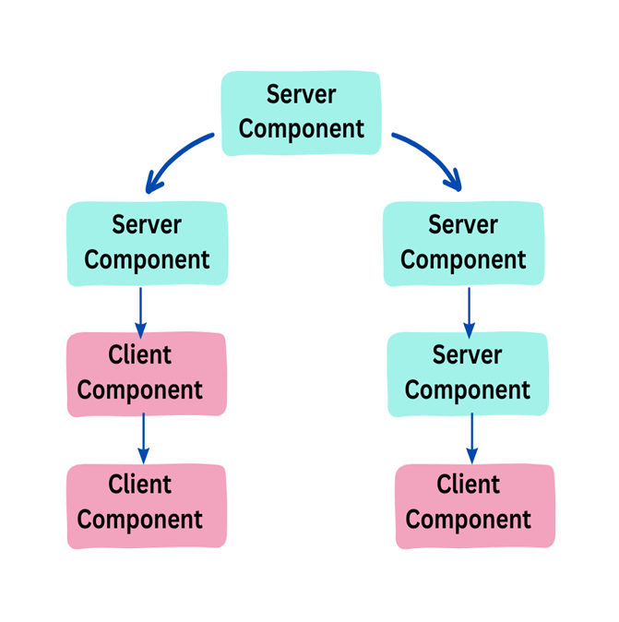
5- What are the Components
Components allow you to build self-contained, reusable snippets of code. you can take these individual bricks and combine them together to form larger structures.
Next.js components are essentially React components. They can be functional or class-based and are used to define how a part of the UI should appear and behave.

Slide 9

Why Use Components in Next.js?
Reusability:
Components can be reused across different pages and parts of the application, making your code DRY (Don't Repeat Yourself).
Organization:
Breaking your UI into components helps keep your code organized and manageable, allowing for easier navigation and maintenance.

Slide 10
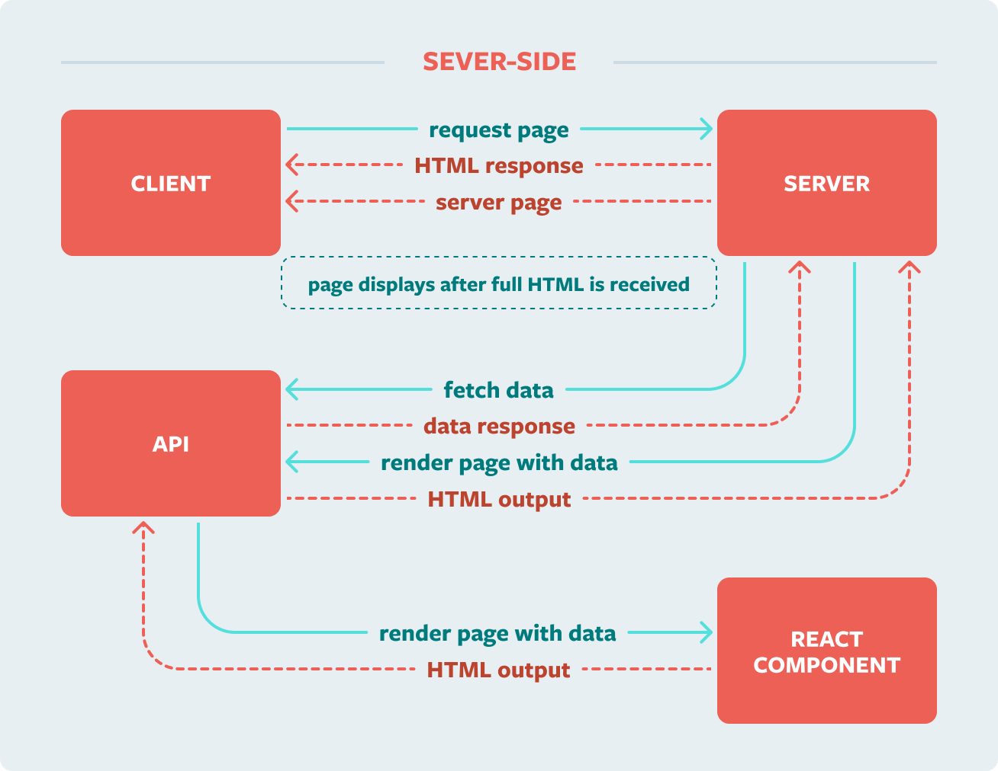
Use Components in Next.js?
Separation of Concerns:
Components can encapsulate specific functionality, separating the logic of a UI element from other parts of the application. This makes it easier to understand and test each component in isolation.
Dynamic Rendering:
Next.js components can leverage features like Server-Side Rendering (SSR) and Static Site Generation (SSG), allowing you to create dynamic, fast-loading applications that are optimized for performance and SEO.

Slide 11
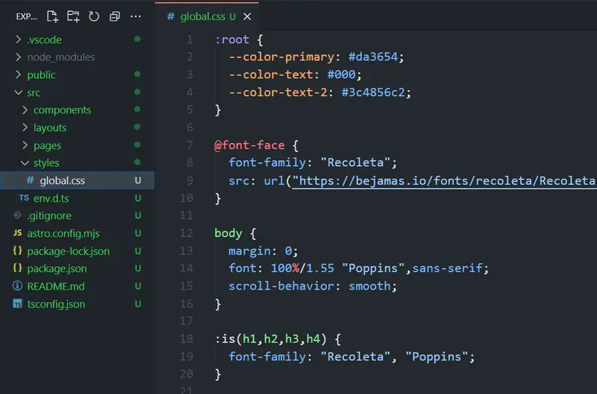
6- How can we apply CSS in Next.js?
In Next.js, you can apply CSS in several ways, allowing for flexibility depending on your project needs. Here are some common methods:
To include global styles, you can create a CSS file and import it in your _app.js file:
Create a CSS file in the styles directory (e.g., styles/global.css).
Import the CSS file in your pages/_app.js:
Global CSS

Slide 12
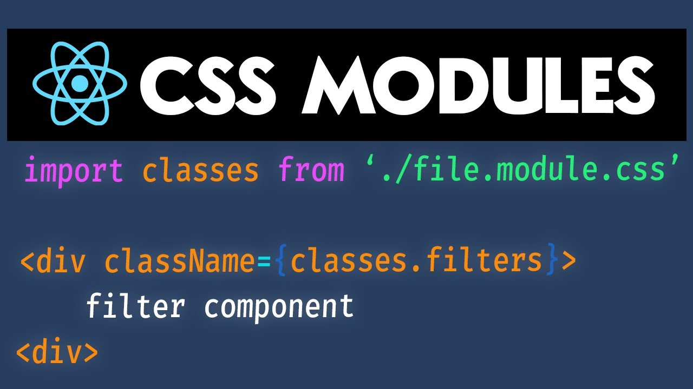
CSS Modules
CSS Modules allow you to write scoped styles. This means styles defined in a module are specific to the component, preventing naming conflicts.
Create a CSS Module file with the .module.css extension (e.g., styles/Home.module.css).
Import the CSS Module in your component:
Shown in side image:

Slide 13
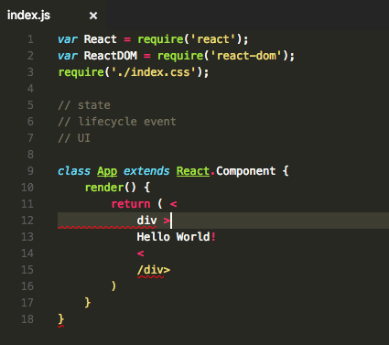
Styled JSX
Next.js supports styled-jsx out of the box, which allows you to write scoped CSS directly within your components.
javascript
function Home() {
return (
<div>
<p>Hello, World!</p>
<style jsx>{`
p {
color: blue;
}
`}</style>
</div>
);
}
export default Home;

Slide 14
Styled Components
You can also use popular CSS-in-JS libraries like Styled Components. First, install the library:
npm installed styled-components
Then, create styled components:
import styled from 'styled-components';
const Container = styled.div` color:red;`;
function Home() {
return <Container>Hello, World!</Container>;}
export default Home;

Slide 15
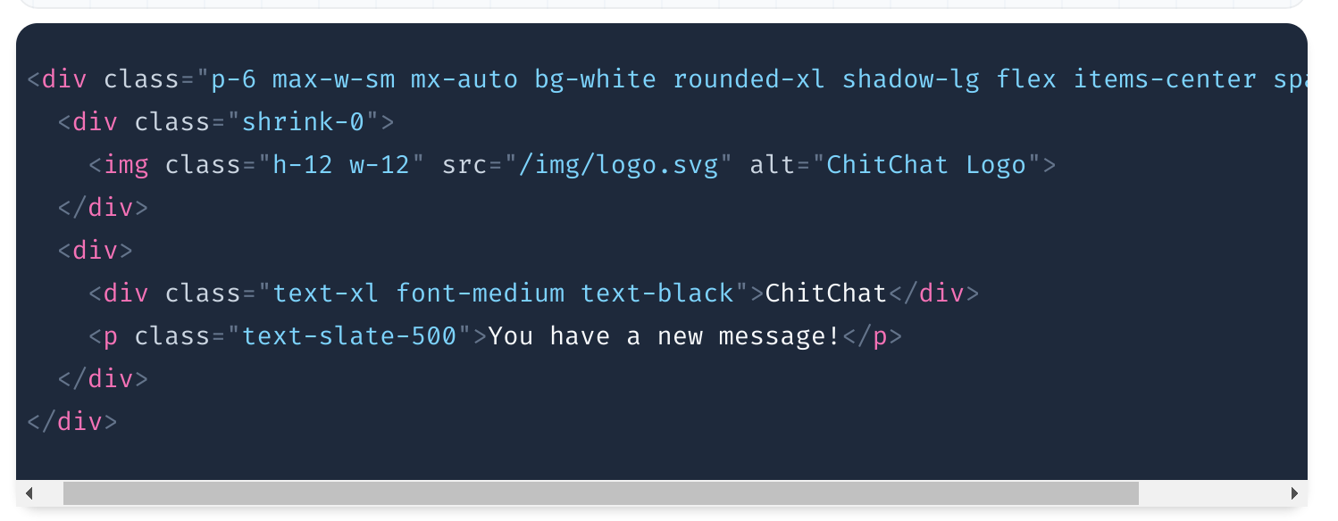
.
Tailwind CSS
Next.js can easily integrate with Tailwind CSS for utility-first
styling. To set it up, follow these steps:
Install Tailwind CSS:
npm install tailwindcss postcss autoprefixer npx tailwindcss init –p
In your globals.css, add the
Tailwind directives.
/* styles/globals.css */ @tailwind base; @tailwind components; @tailwind utilities;

Slide 16

What is Tailwind CSS?
Tailwind CSS
is a utility-first CSS framework that allows developers to build custom designs quickly and efficiently. Unlike traditional CSS frameworks that provide pre-designed components, Tailwind focuses on offering low-level utility classes that can be combined to create unique designs directly in your markup.

Slide 17
Differentiate b/w the Tailwind CSS &
Standard CSS.
S. # | TAILWIND CSS | STANDARD CSS
01 | Utility-First Approach | Utility-First Approach
 | Tailwind CSS uses a utility-first approach, providing small, reusable utility classes for styling directly in your HTML. | This contrasts with standard CSS, where styles are usually defined in separate stylesheets.
02 | Customization | Customization
 | Tailwind is highly customizable through a configuration file, allowing developers to define theme colors, spacing, and breakpoints. | Standard CSS requires manual adjustments for each project.
03 | Readability | Readability
 | Tailwind can improve readability by making the styles explicit within the markup. | Standard CSS often requires looking up styles in separate files, which can make it harder to understand the overall design at a glance.
04 | Development Speed | Development Speed
 | Using Tailwind can speed up development by reducing the need for custom class names and allowing for rapid prototyping. | Standard CSS may require more setup and boilerplate code.

Slide 18
Submitted to:
Thank you and your countless
efforts Sir Hamza Alvi.

